Slide 1
Team++
Lydia Shiffler, Zachary Hughes, Sean Jones, Reilly Zink

Slide 2
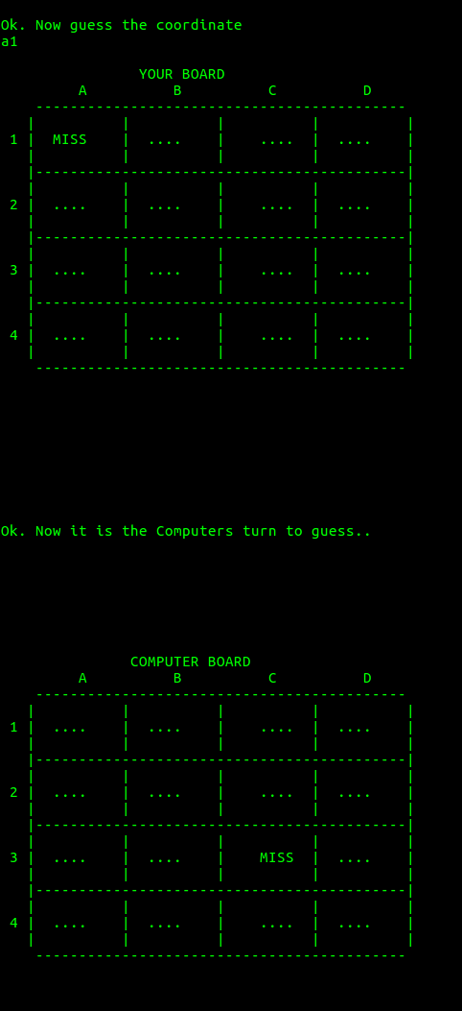
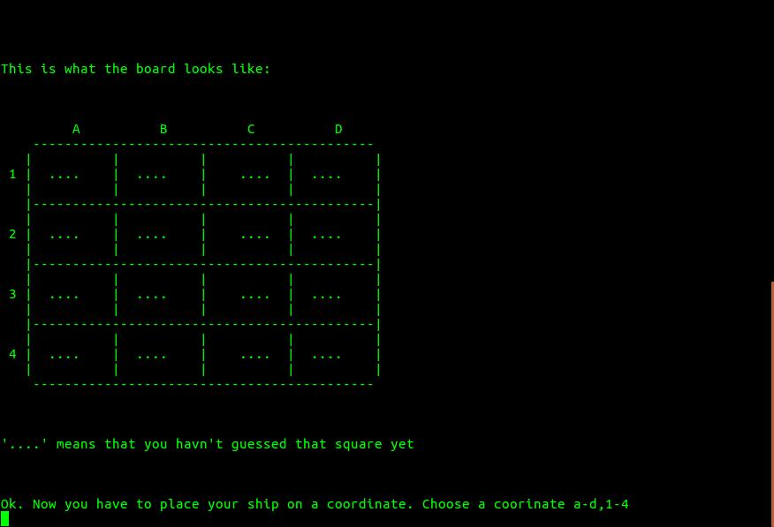
Battleship
This game is a battleship game that puts the player against the computer. There is a visual “board” created using arrays.

Slide 3
What We Plan On Doing
Change the game to give the user the option to play against another player instead of just the computer.
Seperate the code into different files (it is currently all in one file) and make it more organized.
Adding multiple ships to make the game more interesting
Making the battlefield larger
Keeping a list of past moves
The game lets the user pick the same position twice
There are also errors in the code that we plan on fixing.

Slide 4



Tools
Doxygen
Cppcheck
Git
Virtual Box

Slide 5
Github Repository
https://github.com/zhughes96/CS3560_TeamProject.git

